Slide 1
INTERNSHIP PROGRESS · DAY ONE TO NOW
Ultra-Fast Machine-Learned
Force Fields for Molten Salts
Reproducing the SuperSalt benchmark, then building a cheaper, interpretable UF3 model for multicomponent molten chlorides.
Marios Poulis · MSc Materials Science & Engineering, TU Delft · Internship at DIFFER
Progress review · September 2026
Notes:
Good morning. I'm Marios, doing my MSc internship at DIFFER. You've seen the project description, so I'll keep the setup short and focus on what I've done. In short: I'm building a fast, interpretable force field for molten salts — UF3 — and benchmarking it against the state-of-the-art SuperSalt model. I'll cover what that paper did, how I reproduced it, and the 2-body and 3-body models I built.

Slide 2
THE STARTING POINT
What the SuperSalt paper did
MD frames
›
Cluster
›
DFT labels
›
Train MACE
›
Benchmark
MACE-MP0
→ ~70k structures
energies + forces
neural network
accuracy + properties
SuperSalt built a molten-salt-specific model for 11 cations + Cl (12 species): ~70,000 DFT-labelled structures, used to train a MACE neural-network force field.
Reported accuracy: force RMSE 19.6 and 24.4 meV/Å on its two test sets — about 10× better than the generic MACE-MP0 baseline.
Very accurate — but a heavy neural network: expensive to train (~96 GPU-hours) and evaluate, and a black box.
Ultra-Fast MLFF for Molten Salts · Marios Poulis
2
Notes:
SuperSalt is the model I'm measuring against. They generated millions of MD frames, clustered them down to ~70,000 structures, labelled those with DFT, and trained a MACE neural network. It's very accurate — force errors of 19.6 and 24.4 meV per angstrom, about ten times better than a generic baseline. But it's a heavy neural network: ~96 GPU-hours to train, expensive to run, and a black box. That cost and opacity is exactly what I'm trying to improve on.

Slide 3
OUR APPROACH
Reuse their data — build a lighter, interpretable model
Inherit SuperSalt's ~70k DFT dataset directly — skip the expensive frame-generation and DFT steps, start from their labelled data.
First reproduce their benchmark, to prove the pipeline and the error metric are trustworthy.
Then build our own force field with UF3 — the energy written as a sum of simple two-body (pair) and three-body (triangle) terms, fit to the same DFT data by a single linear least-squares solve.
Why UF3: ~1000× cheaper than the neural net, and interpretable — every term is a curve you can plot.
In one line: same data as SuperSalt, a much simpler and cheaper model — how close can it get?
Ultra-Fast MLFF for Molten Salts · Marios Poulis
3
Notes:
My approach is to reuse their ~70k DFT dataset directly — I skip the expensive frame-generation and DFT and start from their labels. Step one is to reproduce their benchmark, to prove my pipeline and metric are trustworthy. Step two is to build my own model with UF3, which writes the energy as a sum of simple two-body and three-body terms, fit by a single linear least-squares solve. It's about 1000 times cheaper than the neural net and, unlike it, interpretable. The real question is: how close can such a simple model get?

Slide 4
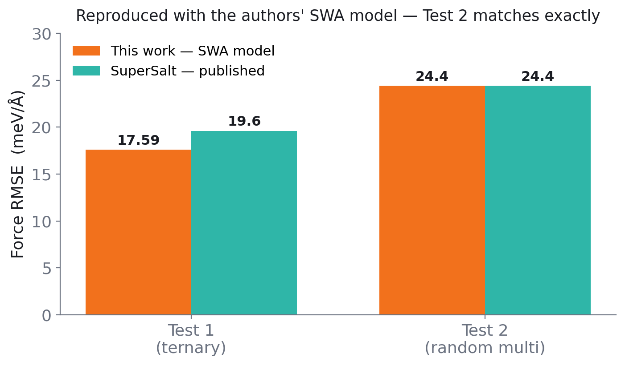
STEP 1 · REPRODUCTION
We reproduced the SuperSalt benchmark
Re-scored the authors' SWA model (the one they actually used) on both official test sets.
Test 2 matched the paper exactly (24.4 meV/Å); Test 1 came out 17.6 vs 19.6 — slightly better.
The small Test-1 difference is a known reproducibility gap (the paper doesn't state which model made each figure) — we independently hit the same ambiguity Daniel documented.
Either way, the data handling and error metric are validated before building anything new.
Takeaway: the pipeline is trustworthy — Test 2 reproduces exactly (24.4) and Test 1 is within ~2 meV/Å.
Ultra-Fast MLFF for Molten Salts · Marios Poulis
4
Notes:
First, validation. I re-scored the authors' actual model — the SWA checkpoint — on both official test sets. Test 2 came out 24.4, matching the paper exactly. Test 1 came out 17.6 versus their 19.6 — actually slightly better. That small difference isn't a bug on my side: the paper never states which checkpoint produced each figure, and the D3 dispersion handling is unclear. That's a reproducibility ambiguity Daniel had already documented, and I hit it independently. Either way, my data handling and error metric are validated before I build anything new.

Slide 5
STEP 2 · OUR MODEL
We built the 2-body UF3 model
12 species
›
B-spline basis
›
Featurize
›
One linear solve
→ 78 pair types
→ 1,416 coefficients
structures → matrix
least-squares fit
Each pair of the 12 elements gets its own learned distance-curve — 78 pair types, 1,416 coefficients total.
Because the energy is linear in those coefficients, fitting the whole 12-species model is one matrix solve — no slow neural-network training.
Trained on the SuperSalt DFT data, scored on the same held-out test sets.
Ultra-Fast MLFF for Molten Salts · Marios Poulis
5
Notes:
Then I built my own 2-body UF3 model. For 12 species there are 78 distinct pair types; each becomes a flexible B-spline curve, giving 1,416 coefficients in total. The key point: because the energy is linear in those coefficients, fitting the whole 12-species model is a single matrix solve — no slow, iterative neural-network training. I trained on the SuperSalt DFT data and scored on the same held-out test sets, so the comparison is fair.

Slide 6
STEP 2 · RESULT
The 2-body model hits a floor
13–15
280–310
flat
energy MAE (meV/atom)
force RMSE (meV/Å)
learning curve vs data
The force error stays in a band and does not fall as more training data is added — a sign the model is at its structural limit, not data-limited.
Why: a 2-body term only sees the distance of each pair — there is no angle in it, so it cannot capture coordination geometry.
Cheaper and interpretable, but clearly a floor to build on — which is what motivates the 3-body term.
Ultra-Fast MLFF for Molten Salts · Marios Poulis
6
Notes:
The 2-body model lands around 280 to 310 meV per angstrom on forces. The important observation is that this number does not fall as I add more training data — it stays flat. That's the signature of a model at its structural limit, not one starved of data. The reason is physical: a 2-body term only sees the distance between two atoms — there's no angle in it — so it can't represent coordination geometry. It's cheap and interpretable, but clearly a floor. That's what motivates adding the 3-body term.

Slide 7
STEP 3 · THE 3-BODY TERM
Adding angles — with a subsystem model
The 3-body term uses a triangle of three atoms, so it can see the angle the 2-body term was blind to.
But the full 12-species 3-body model is intractable — 936 triplet types → 111,216 features (a ~100 GB matrix that won't fit).
936
111,216
~100 GB
triplet types
features
won't fit in memory
The workaround — a subsystem model
Cut to a tractable 3-element subsystem (18 triplet types instead of 936) and ask directly: does the angular term help?
Test a directional cation (Mg, Zr) where it should — against a spherical control (K/Rb) where it should not.
Ultra-Fast MLFF for Molten Salts · Marios Poulis
7
Notes:
The 3-body term uses triangles of three atoms, so it can finally see the angles the 2-body term was blind to. The catch is that the full 12-species version is intractable: 936 triplet types, over 111,000 features, a roughly 100 GB matrix that won't fit in memory. So I ran a controlled experiment instead — cut down to a 3-element subsystem with only 18 triplet types, and directly test whether the angular term helps: a directional cation where it should, against a spherical control where it shouldn't.

Slide 8
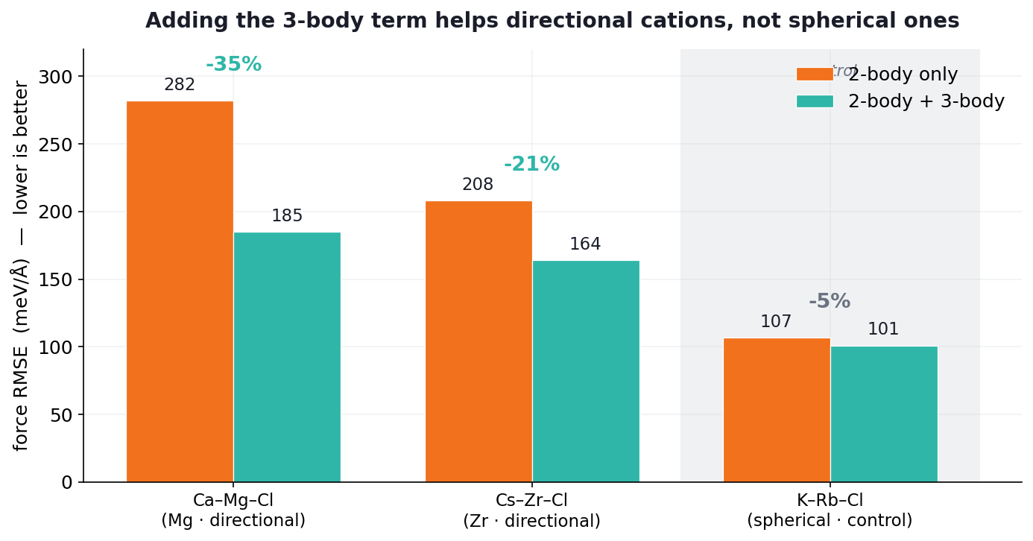
STEP 3 · RESULT
The 3-body term helps — where it should
Directional
Mg −35%
Zr −21%
Spherical control
K/Rb −5%
The gain tracks the cation: big for directional Mg and Zr, negligible for the spherical control — exactly the coordination physics a pair model misses.
Ultra-Fast MLFF for Molten Salts · Marios Poulis
8
Notes:
And it behaves exactly as the physics predicts. For the directional cations, Mg and Zr, adding the 3-body term cuts the force error by 35 and 21 percent. For the spherical control, potassium and rubidium, it barely moves — about 5 percent. The improvement tracks the cation's directionality, which is strong evidence the angular term is capturing real coordination physics — not just adding parameters that happen to help.

Slide 9
WHERE WE ARE & WHAT'S NEXT
Status and next steps
Done
Next
Reproduced the SuperSalt benchmark within ~1 meV/Å.
Built a 12-species 2-body UF3 model — established its accuracy floor.
Built a 3-body subsystem model — showed the angular term helps directional cations (Mg −35%, Zr −21%) but not the spherical control.
Packaged a reproducible pipeline and handed it to DIFFER's compute.
Scale the models up on the cluster (larger 2-body, larger 3-body).
The headline figure: accuracy vs computational cost, UF3 vs SuperSalt.
Predict molten-salt properties via molecular dynamics (density, RDF, diffusion).
Write up the 2-/3-body results for the thesis.
Thank you — questions welcome.
Notes:
To summarise: I reproduced the SuperSalt benchmark, built and characterised a full 2-body model, and demonstrated the value of the 3-body term on subsystems — all validated and packaged reproducibly, and now handed off to DIFFER's compute. Next steps are to scale the models up on the cluster, produce the headline accuracy-versus-cost figure against SuperSalt, and begin predicting molten-salt properties with molecular dynamics. Happy to take questions.

